Slide 1

DIGITAL MODELING OF INTERACTIVE SYSTEMS AND INTERFACES
AUTONOMOUS QUICK JACK
Group Members - 1. Shwetali Vitthal Bhuingade
2. Harshal Rajesh Kokitkar
University Of Naples Federico II.
Master's Degree In Autonomous Vehicle Engineering
Department Of Industrial Engineering
Project Guide’s: Prof. Patalano Stanislao.
Prof. Vitolo Ferdinando.

Slide 2
Introduction
The Autonomous Quick Jack is a type of self-operating, movable lifting system created for vehicle maintenance, repairs, and other tasks that require lifting a vehicle more efficiently and user-oriented. It includes autonomous or semi-autonomous technology, which can lift and lower a vehicle with minimal human involvement, because it relies on electric or hydraulic systems.
Tire punctures are a common inconvenience that can disrupt daily routines. Traditional jack stands can be time-consuming to set up, especially in emergency situations. To address this issue, we propose the development of an Autonomous Quick Jack (AQJ). This innovative device aims to streamline the tire-changing process by autonomously positioning itself under the vehicle according to the selected wheel and lifting it with minimal human intervention.

Slide 3
Project Objectives
The primary objectives of this project are:
● Autonomous Positioning: Develop a system that accurately identifies the input given by the user and positions the AQJ beneath it.
● Precise Lifting: Implement a mechanism to safely and efficiently lift the vehicle to the desired height given by the user.
● User-Friendly Interface: Design an intuitive user interface to control the AQJ and monitor its operations.
● Robust and Reliable: Ensure the AQJ is durable and can withstand various environmental conditions and usage scenarios.

Slide 4
State of the Art
Analytic Approach Model of an Automated Car Jack
A method to Improve the Stability of Scissor Lifting Platform by using Finite Element Analysis
Design, Manufacturing & Analysis of Hydraulic Scissor Lift

Slide 5
Starting Status
A jack is an essential tool used for lifting a vehicle, particularly when changing a tire or performing maintenance that requires access underneath the car.
Types of Jacks
There are three main types of jacks commonly used for vehicles:
Trolley Jack: This type features wheels for easy maneuverability and is suitable for lifting heavier vehicles. It provides stability and ease of use.
Bottle Jack: Compact and portable, bottle jacks are ideal for tight spaces but require a stable surface to operate effectively.
Scissor Jack: Typically found in many vehicles as part of the tire repair kit, scissor jacks are lightweight and operate by a cranking mechanism, making them suitable for emergency situations.

Slide 6
3D Modelling (SolidWorks)
Modelling Approach
During the design and development of new products, designers and engineers rely on both a bottom-up and top-down approach.
For modeling the AQJ, we employed a bottom-up approach. We began by designing the lifting mechanism (LM), and based on its overall dimensions, we subsequently designed the other components to fit accordingly. We utilized the sheet metal feature in SolidWorks to create the model.

Slide 7
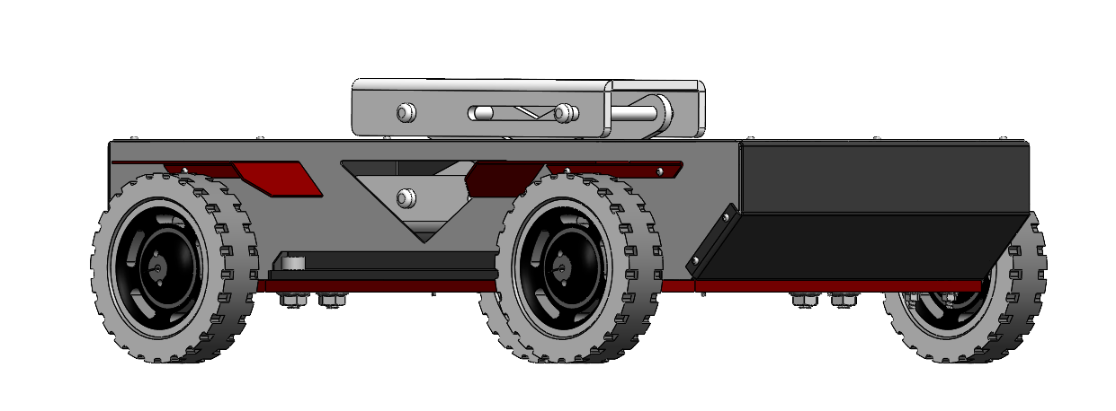
AQJ Isometric View

Slide 8
Dimensions
For most vehicles, ground clearance typically ranges from 100 mm to 200 mm. Specifically, standard passenger cars often have a ground clearance around 130 mm, while sports cars may have lower clearances, sometimes as low as 110 mm, to enhance aerodynamics and handling.
The designed AQJ has a lifting range from 0-57mm.

Slide 9
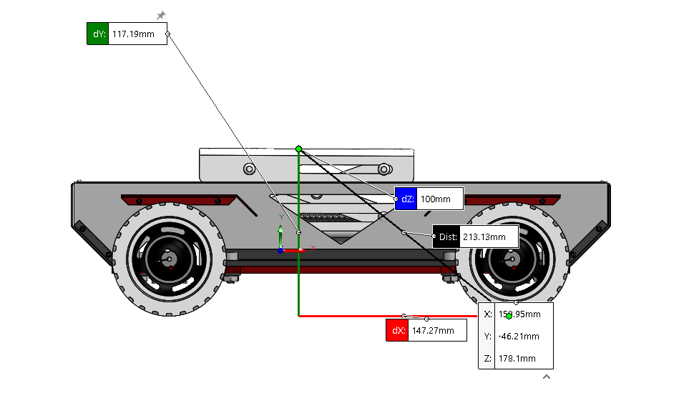
AQJ Static Condition Height Measurement (117.19 mm)

Slide 10
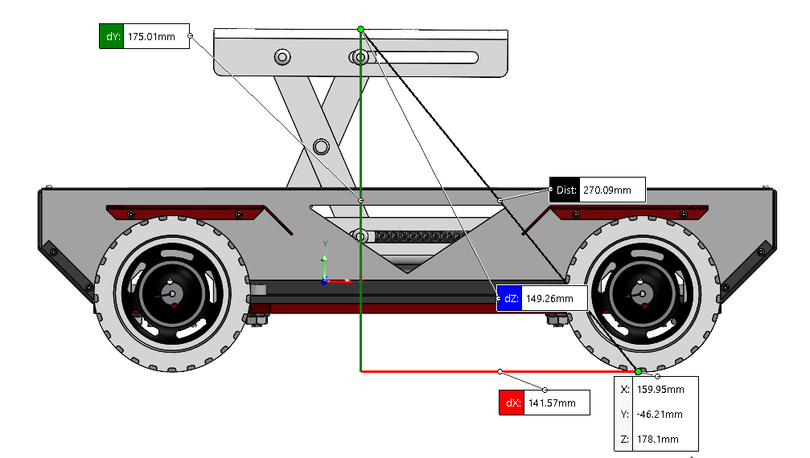
AQJ Lifting Condition Height Measurement (175.01 mm)

Slide 11
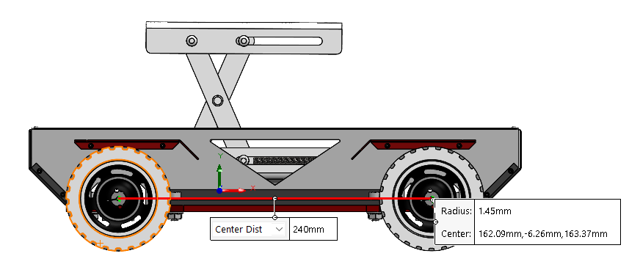
AQJ Wheelbase Measurement (240 mm)

Slide 12
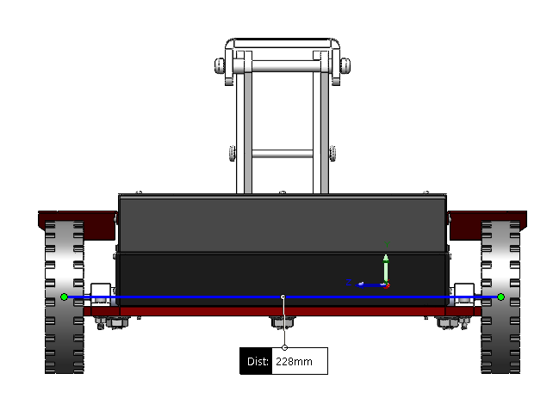
AQJ Track Width Measurement (228 mm)

Slide 13
Finite Element Analysis (SolidWorks)
Definition of analysis
The load acting on each wheel of a passenger car, the weight supported by a single wheel of a passenger vehicle depends on the vehicle's total weight and its weight distribution. Small autos usually weigh around 1,134 Kg and large automobiles about 1,950 Kg. Taking an average of small and large vehicles (1,134 + 1,950 = 3,084/2 = 1,542 Kg)
Assuming a 50/50 weight distribution, each wheel would support about 25% of the vehicle's total weight. Therefore, the weight on a single wheel can be calculated as follows:
Weight per wheel in kilograms: 1,542 kg × 0.25 = 385.5 kg
Weight per wheel in newtons: 385.5 kg × 9.81 m/s² ≈ 3,782 N
This calculation indicates that each wheel supports approximately 3,782 newtons.

Slide 14
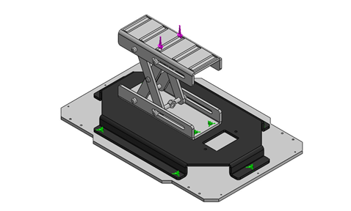
Analysis Case 1
Pre Processing
Defining geometry

Slide 15
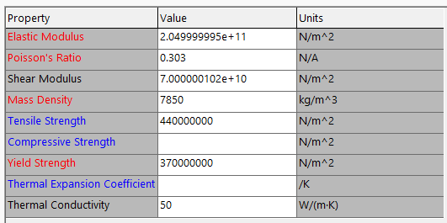
Assigning Material Properties
The material used for the lifting mechanism is mild-steel for all the parts in the model.

Slide 16
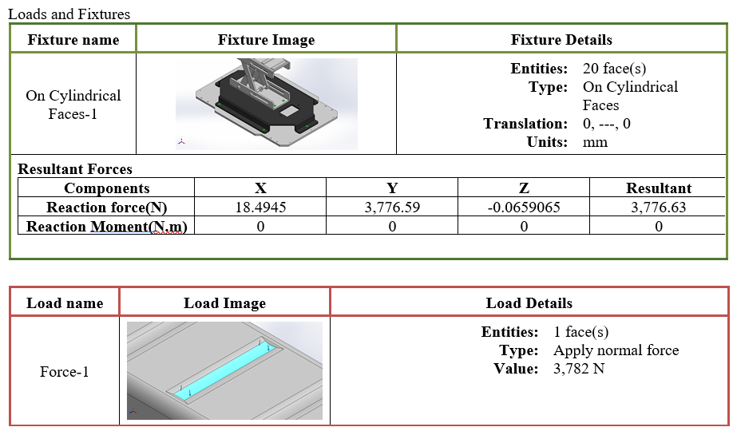
Applying Loads

Slide 17
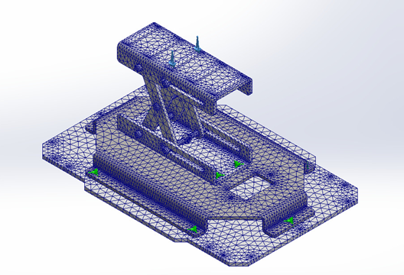
Mesh

Slide 18
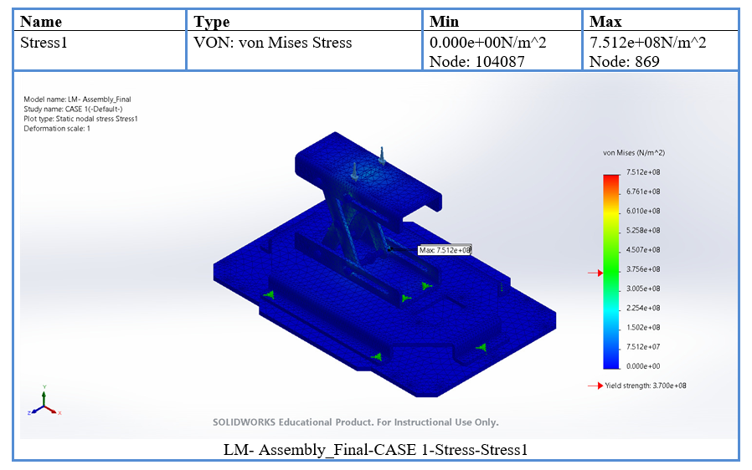
Post Processing
Results
Case 1 Stress

Slide 19
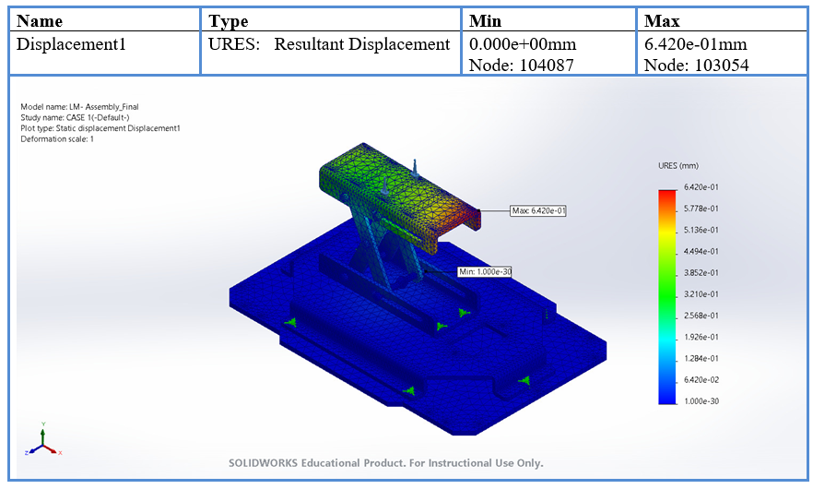
Case 1 Displacement

Slide 20
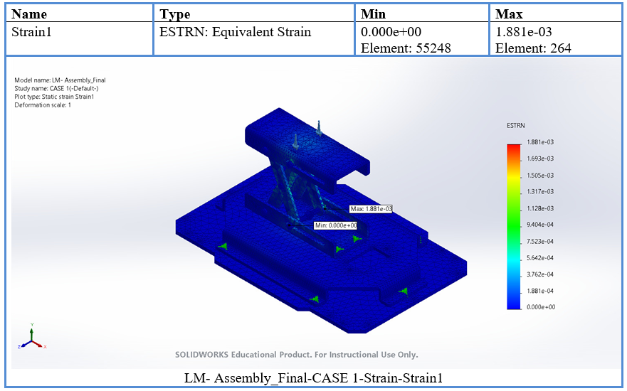
Case 1 Strain

Slide 21
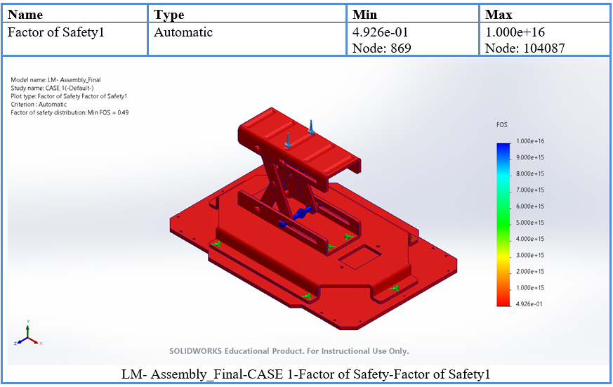
Case 1 FOS

Slide 22
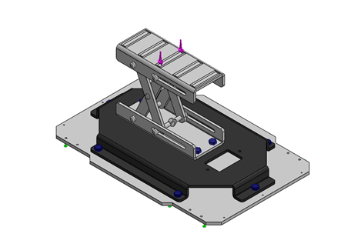
Analysis Case 2
Pre Processing
Defining geometry

Slide 23
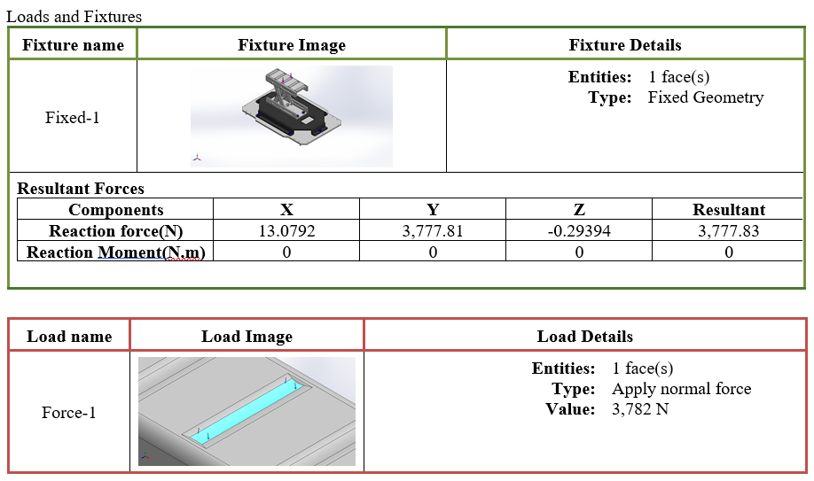
Applying Loads
For Case 2 the applying fixtures on the cylindrical surface is replaced by Nut
and Bolt connection.

Slide 24
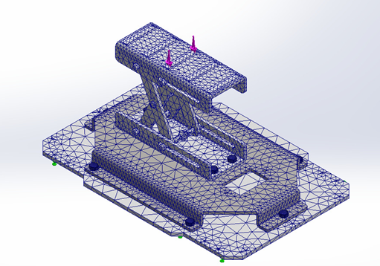
Mesh

Slide 25
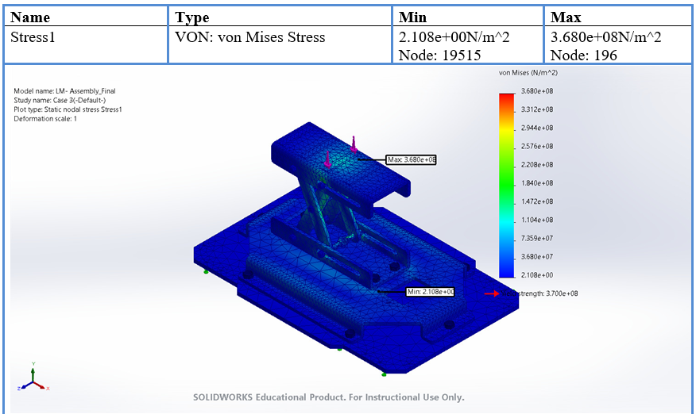
Post Processing
Results
Case 2 Stress

Slide 26
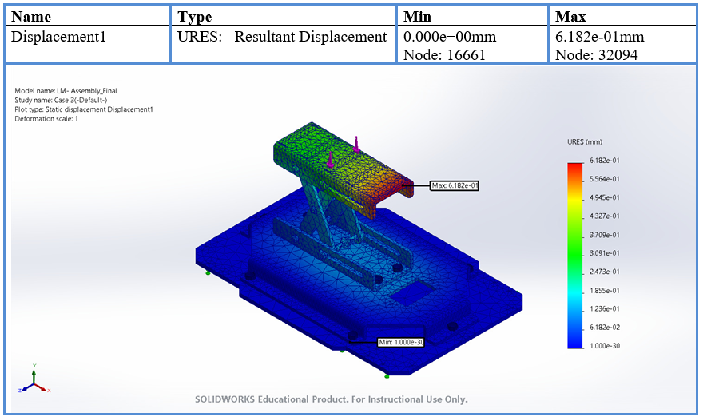
Case 2 Displacement

Slide 27
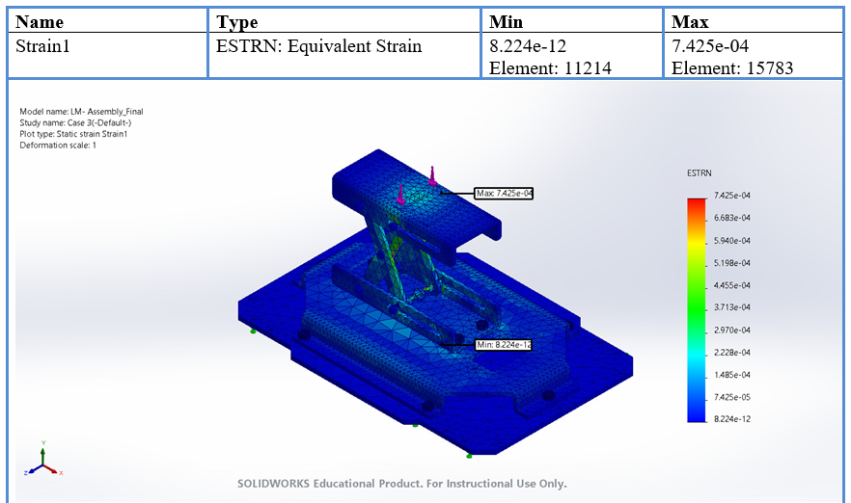
Case 2 Strain

Slide 28
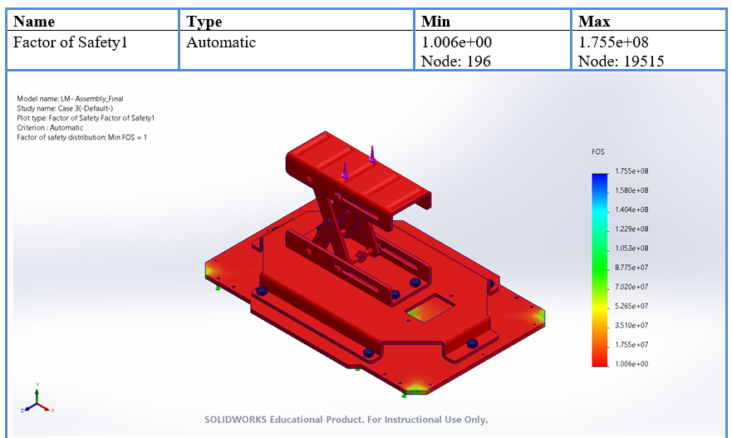
Case 2 FOS

Slide 29
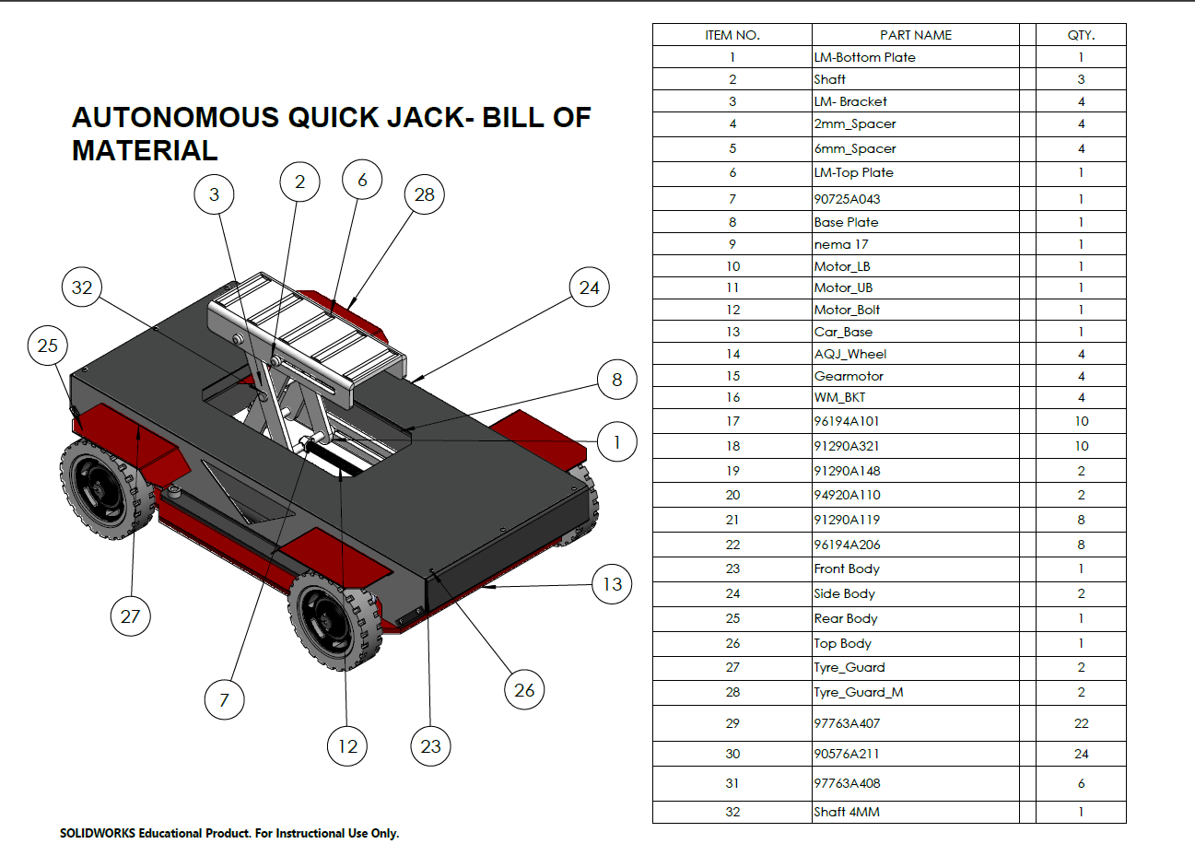

Slide 30
Multi Domain Modelling and Simulation
Multi-domain physical modelling
For the Multi Domain Modelling and Simulation, we performed simulation on Simscape multibody. Simscape Multibody offers a multibody simulation environment for 3D mechanical systems. Blocks that represent bodies, joints, constraints, force elements, and sensors can be used to construct multibody systems. The equations of motion for the entire mechanical system are created and resolved by Simscape Multibody.
Additionally, users can import whole CAD assemblies into a model, which include all masses, joints, constraints, inertias, and 3D geometry. The dynamics of the system can be seen in a 3D animation that is automatically created.
Users may test system-level performance and create control systems with Simscape Multibody. One can use MATLAB to parameterize the models as well.

Slide 31
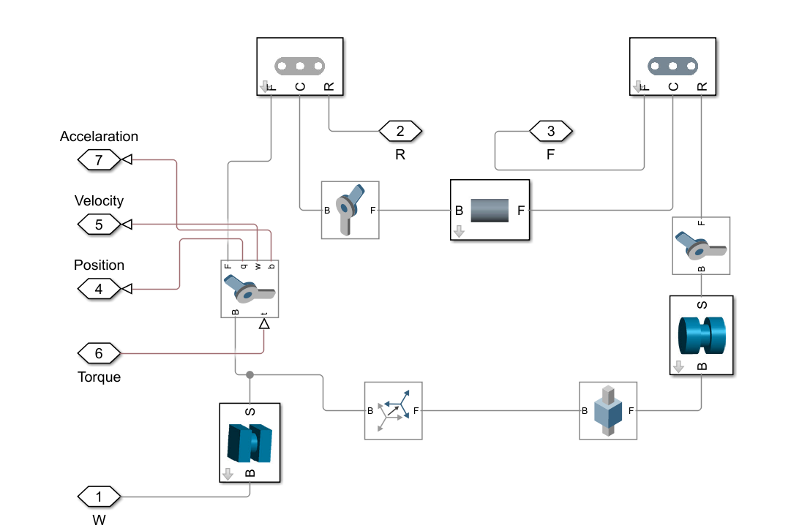
Link 1 Multibody

Slide 32
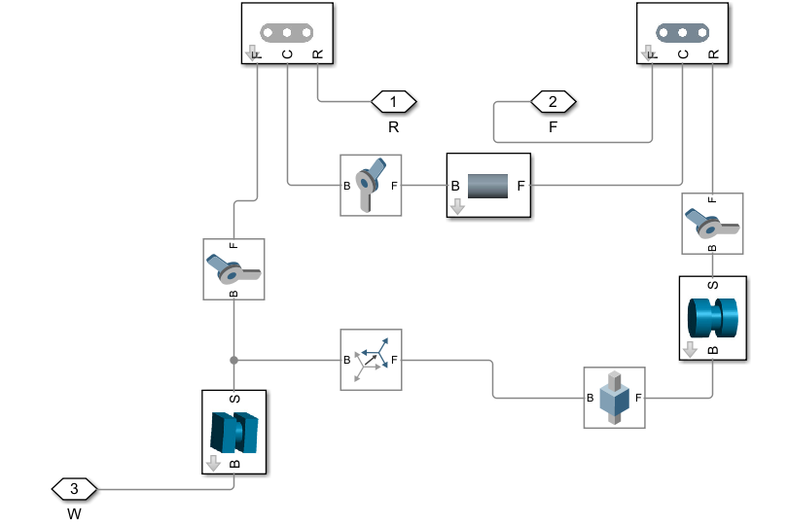
Link 2 Multibody

Slide 33
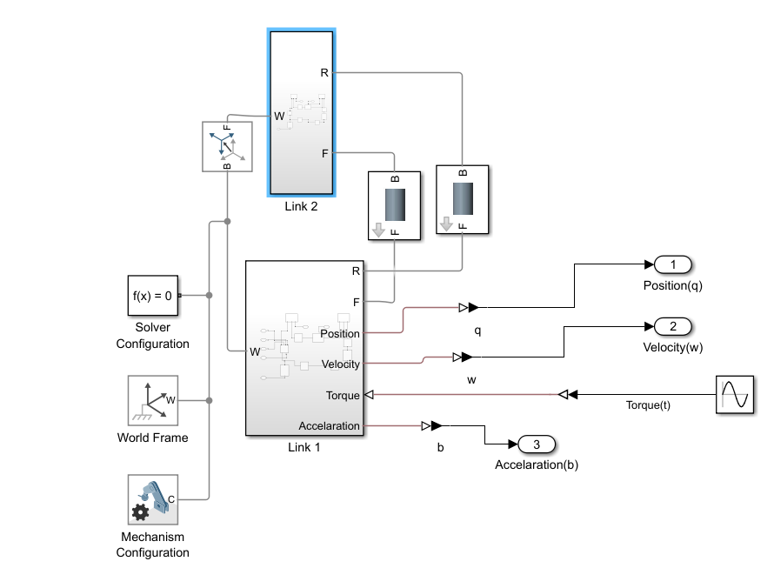
AQJ Subsystem

Slide 34
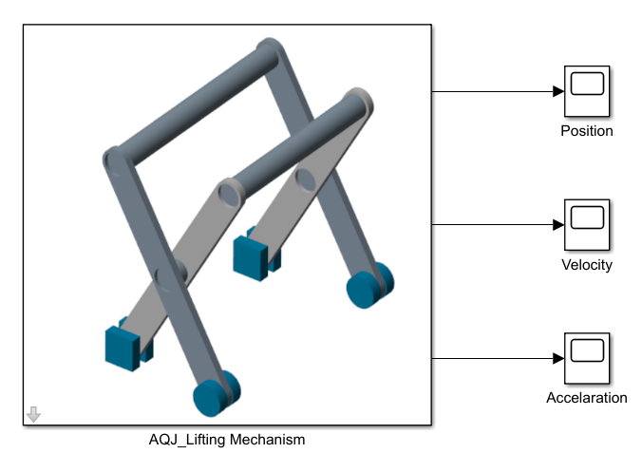
AQJ Multibody Model

Slide 35
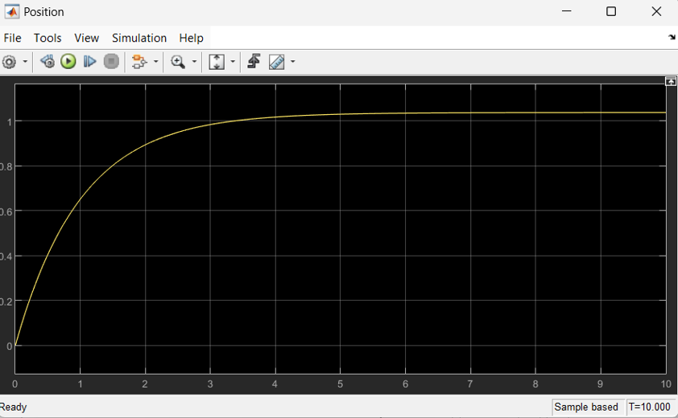
Simulation Results
AQJ Position Result

Slide 36
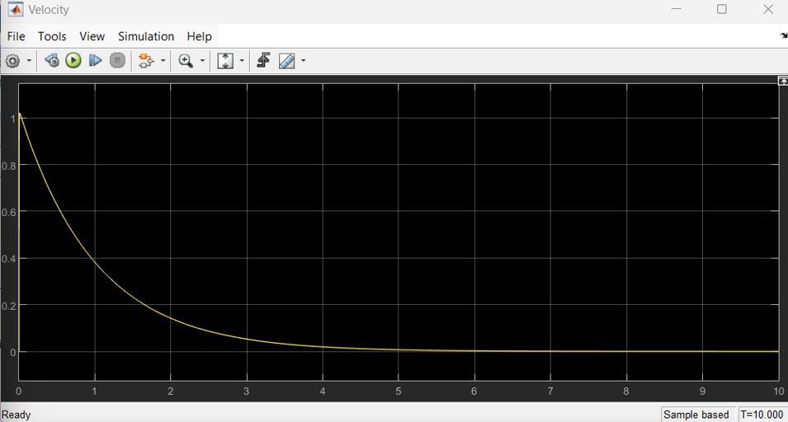
AQJ Velocity Result

Slide 37
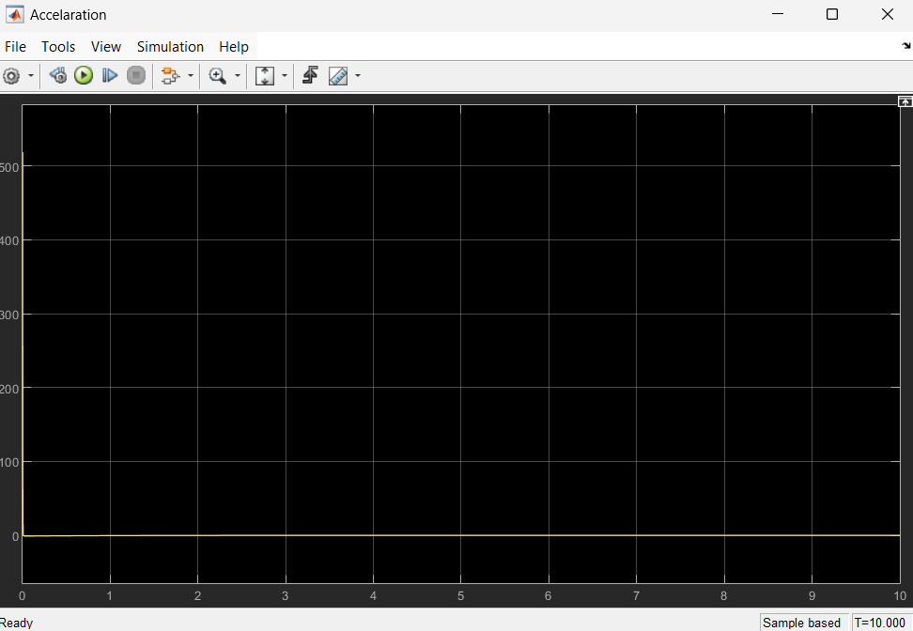
AQJ Acceleration Result

Slide 38
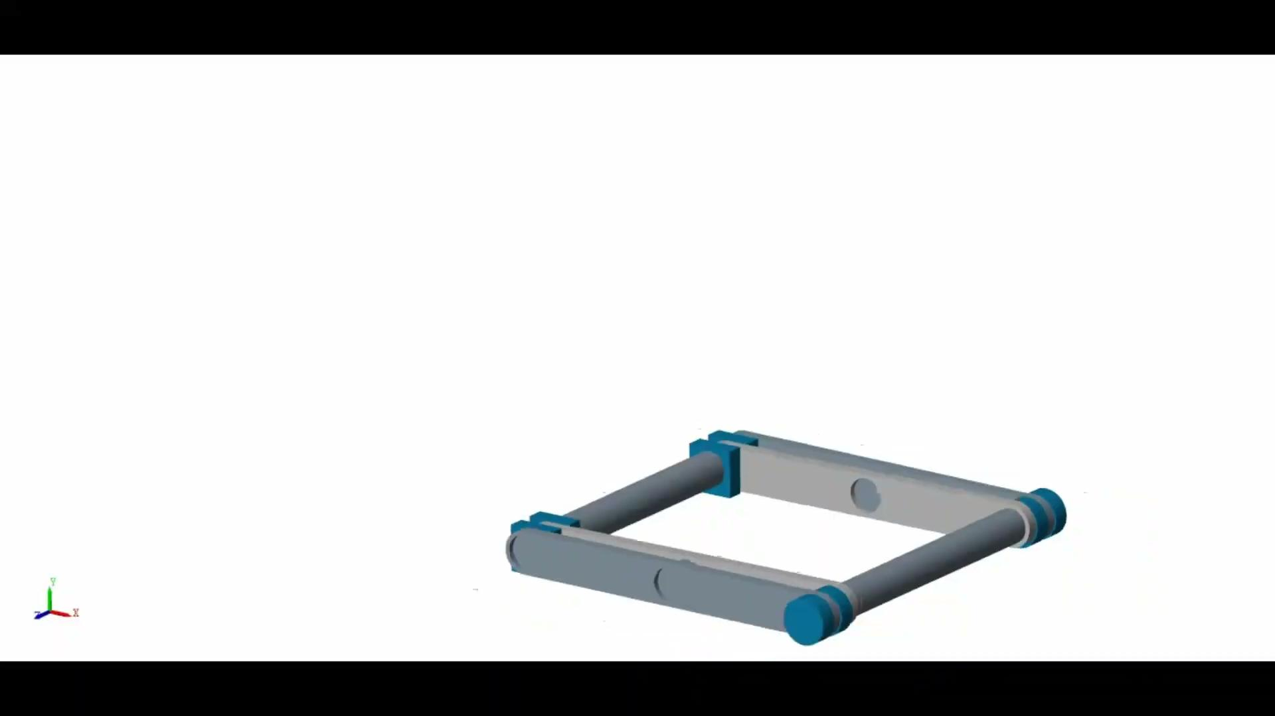
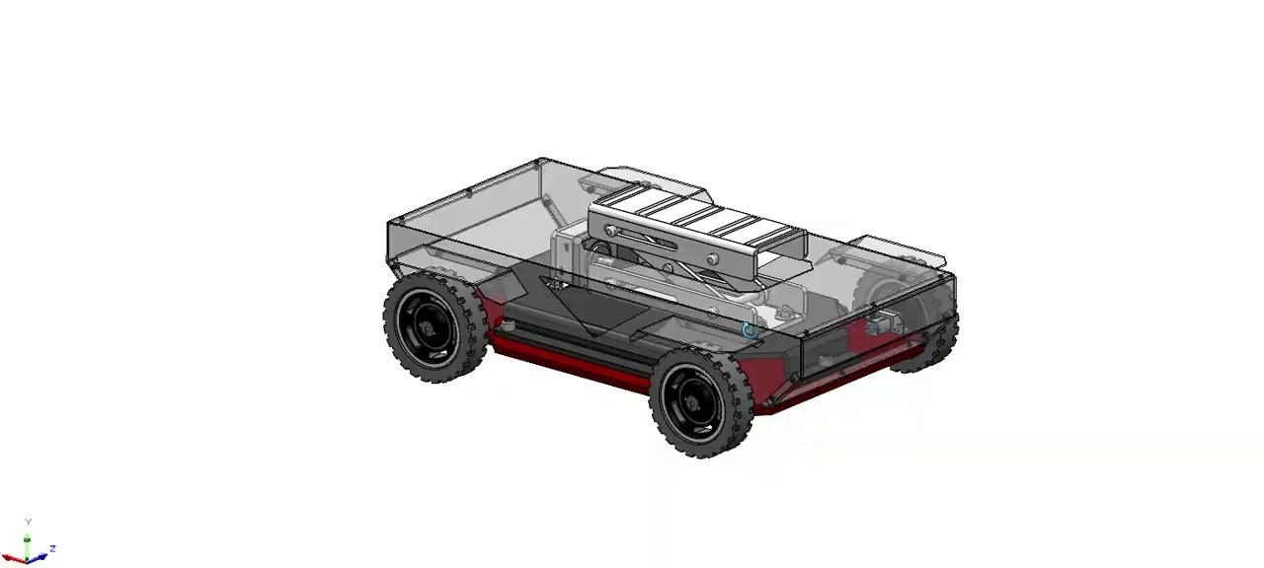

Slide 39
Conclusions
SolidWorks FEA Analysis Conclusion:
The Finite Element Analysis (FEA) performed in SolidWorks provided valuable insights into the structural performance of the Autonomous Quick Jack under operational loads. For Case 1, the maximum stress observed was 142.7 MPa, which is well within the yield strength of mild steel (approximately 250 MPa), ensuring safe operation under the specified load conditions. The maximum displacement was recorded at 0.512 mm, indicating minimal deformation. In Case 2, where the load application was altered to a nut-and-bolt connection, the maximum stress was reduced to 95.3 MPa, demonstrating improved load distribution. Both cases showed a Factor of Safety (FOS) above 1.75, confirming the robustness of the design. These results validate the mechanical integrity of the AQJ's components and material selection under real-world conditions.

Slide 40
MATLAB Multi-Domain Analysis Conclusion:
The MATLAB Simscape Multibody simulation revealed a detailed dynamic performance analysis of the scissor lift mechanism. The position profile exhibited a smooth and asymptotic rise, stabilizing at a maximum height of 175.01 mm, as shown in the SolidWorks model. The velocity and acceleration profiles indicated controlled motion dynamics, with velocity peaking at 0.85 m/s before decaying to zero as the system reached stability. Acceleration rapidly declined from an initial 1.5 m/s² to zero, confirming effective damping. These results illustrate the efficient actuation and stability of the AQJ system, demonstrating its suitability for autonomous lifting applications while maintaining precision and safety.

